Slide 1

Seguros Equinoccial Auto Conectado Risk Model
February, 2020

Slide 2


About AutoConectado
AutoConectado is a product of the solution developed by IBM Ecuador for Seguros Equinoccial [SESA] to record telemetry data from cars of SESA’s clients.

Slide 3

Objective of this project
Develop a mathematical model to classify AutoConectado devices into used-based clusters using telemetry data.

Slide 4
Steps
1. Sample selection
2. Descriptive Analysis
3. Data Segmentation
4. Classification Model
5. Deployment of the classification model
6. Development of control panels for the model
7. Solution automatization
8. Evolution

Slide 5
Steps
1. Sample selection
2. Descriptive Analysis
3. Data Segmentation
4. Classification Model
5. Deployment of the classification model
6. Development of control panels for the model
7. Solution automatization
8. Evolution

Slide 6
1. Sample selection
7,250
🚗 Devices
9
🗓months
(Jan-Sep/19)

Slide 7
1. Sample selection Feature engineering
Feature engineering
166 variables
Initial variable selection
110 variables
Final variable selection
44 variables
56 totals
54 percentages
56 percentiles
54 percentages
56 de percentiles
Trip aggregations
Day aggregations
Device aggregations
Notes:
Crash Alert 2.5 en funcionamiento desde Marzo 2018

Slide 8
Steps
1. Sample selection
2. Descriptive Analysis
3. Data Segmentation
4. Classification Model
5. Deployment of the classification model
6. Development of control panels for the model
7. Solution automatization
8. Evolution

Slide 9
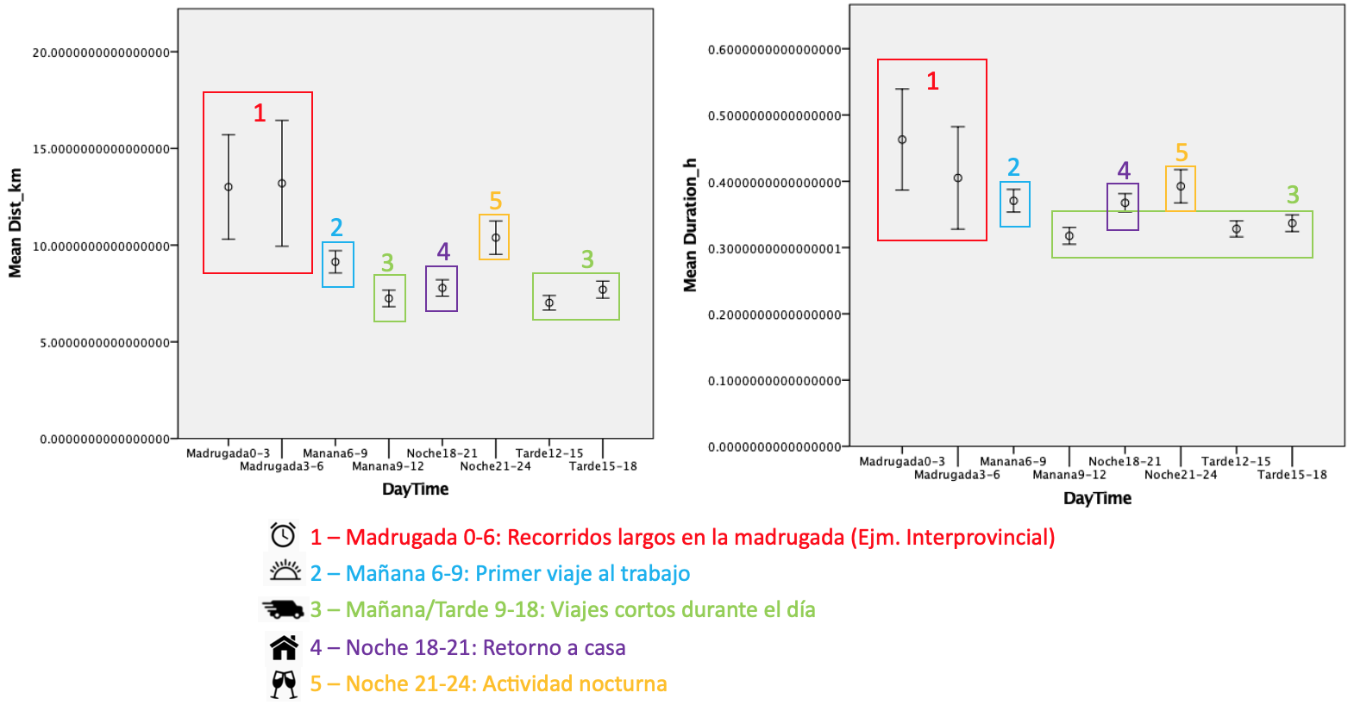
2. Descriptive Analysis
a) Mean comparisons of periods of the day

Slide 10
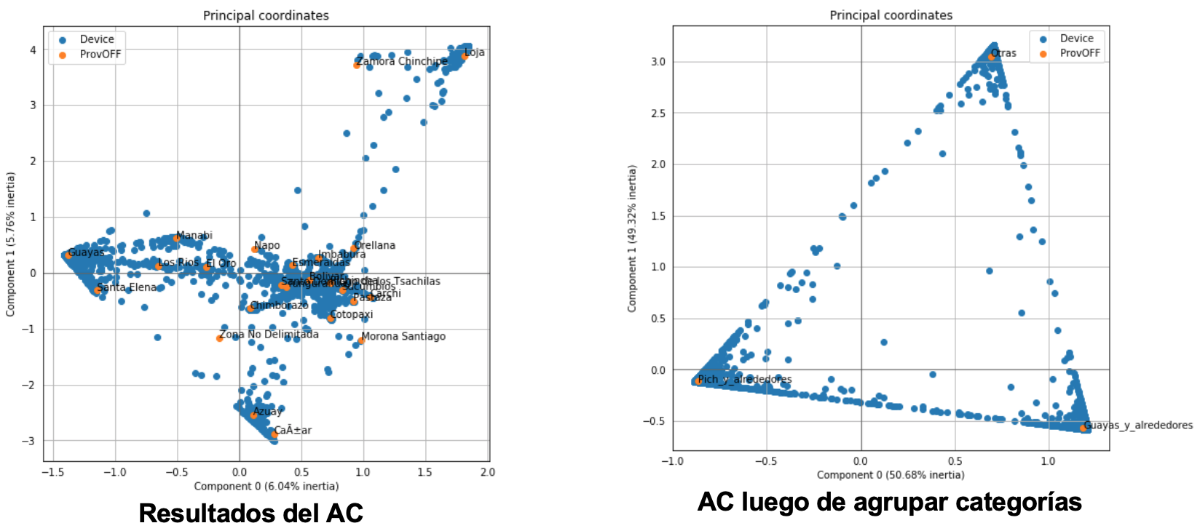
2. Descriptive Analysis
b) Correspondence Analysis for geographic variables

Slide 11
Steps
1. Sample selection
2. Descriptive Analysis
3. Data Segmentation
4. Classification Model
5. Deployment of the classification model
6. Development of control panels for the model
7. Solution automatization
8. Evolution

Slide 12
3. Data Segmentation
Software: IBM SPSS Statistics
Dimensionality Reduction: Principal Component Analysis (PCA)
Clustering Algorithm: Two-Step Cluster
3 leves of segmentation:
Pichincha
Guayas
Otros
Alto
Alto
Medio
Bajo
Medio
Bajo

Slide 13
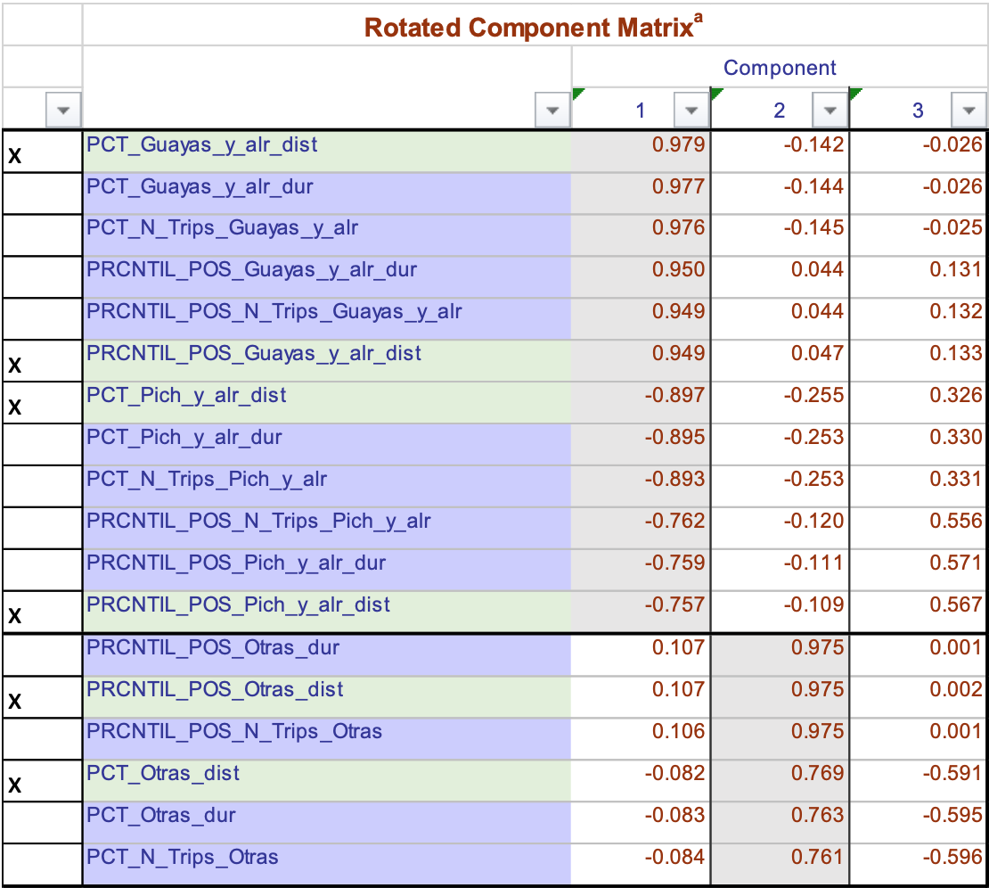
Level 1 – Geographic: PCA Results
Variable | Detail
PCT_Guayas_y_alr_dist | Percentage of kilometers driven on Guayas group.
PRCNTIL_POS_Guayas_y_alr_dist | Percentile of kilometers driven on Guayas group.
PCT_Pich_y_alr_dist | Percentage of kilometers driven on Pichincha group.
PRCNTIL_POS_Pich_y_alr_dist | Percentile of kilometers driven on Pichincha group.
PCT_Otras_dist | Percentage of kilometers driven on Otras group.
PRCNTIL_POS_Otras_dist | Percentile of kilometers driven on Otras group.
The variables marked with an “x” were selected for the clustering part.

Slide 14
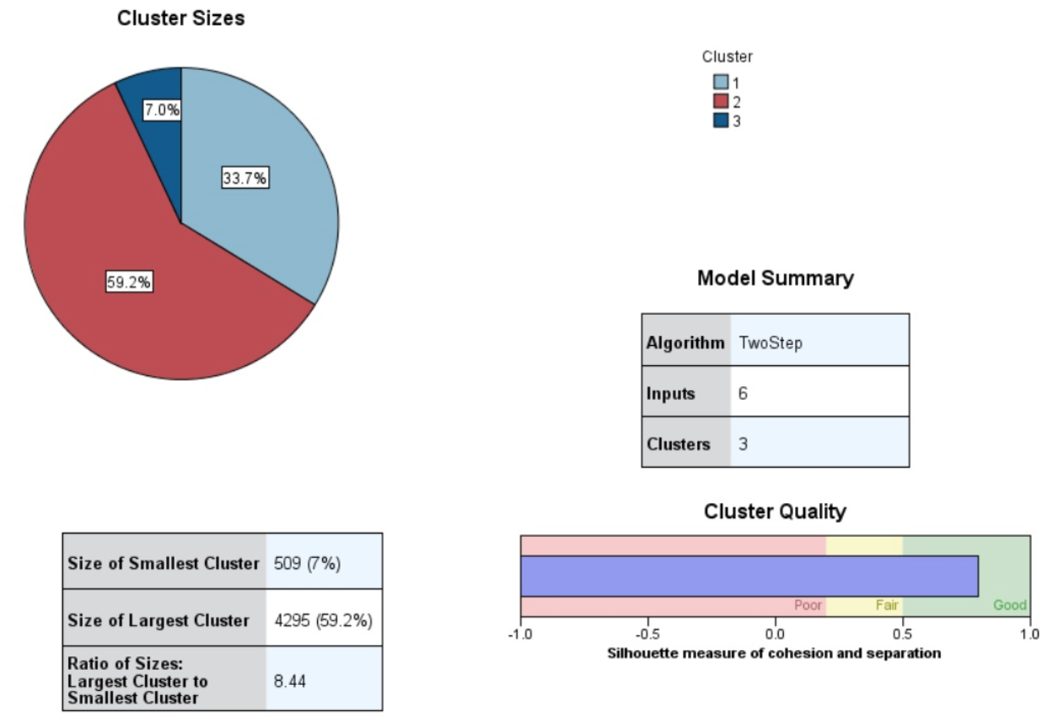
Level 1 – Geographic: Two-Step results
Guayas y sus alrededores
Pichincha y sus alrededores
Otros y sus alrededores

Slide 15
Level 1 – Geographic: Cluster composition
Cluster Number | Number of devices | Geographic Zone
1 | 2446 | Guayas
2 | 4295 | Pichincha
3 | 509 | Otros

Slide 16
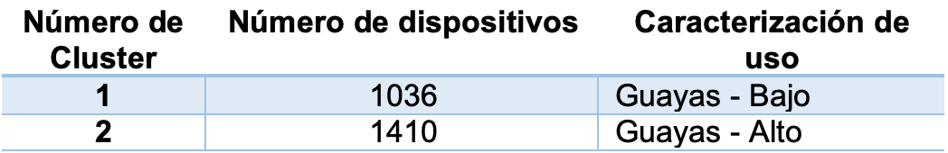
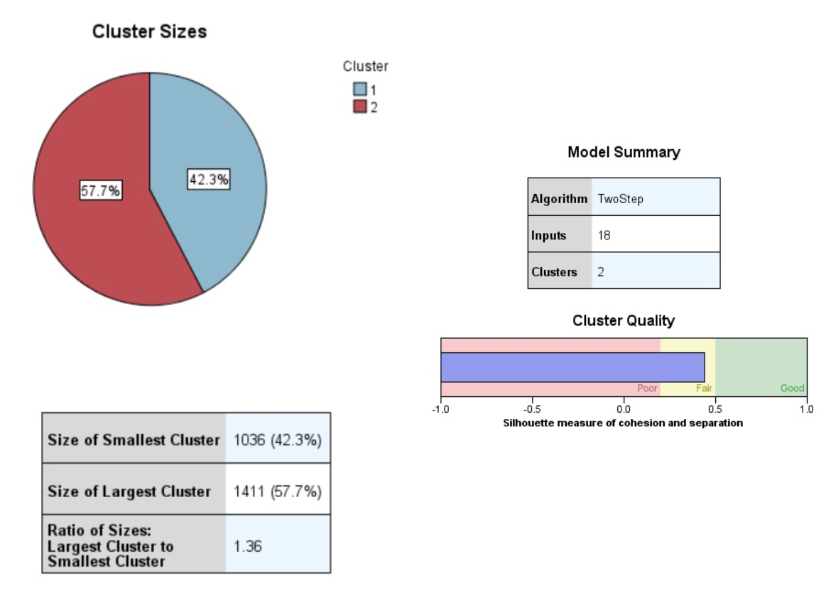
Level 2: Guayas

Slide 17
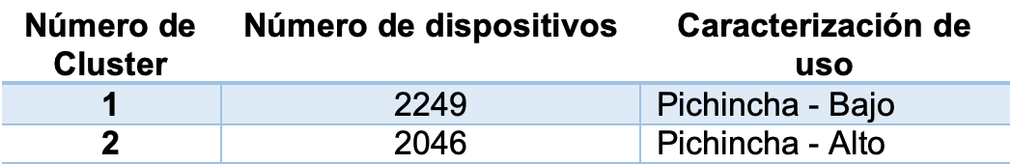
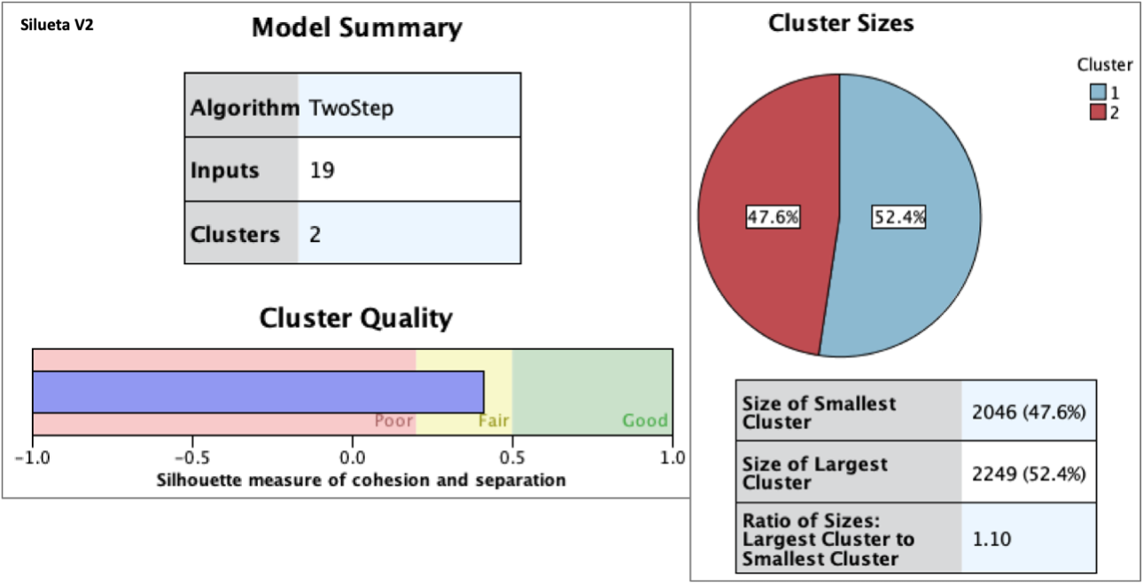
Level 2: Pichincha

Slide 18
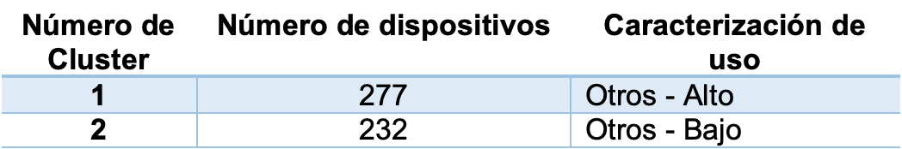
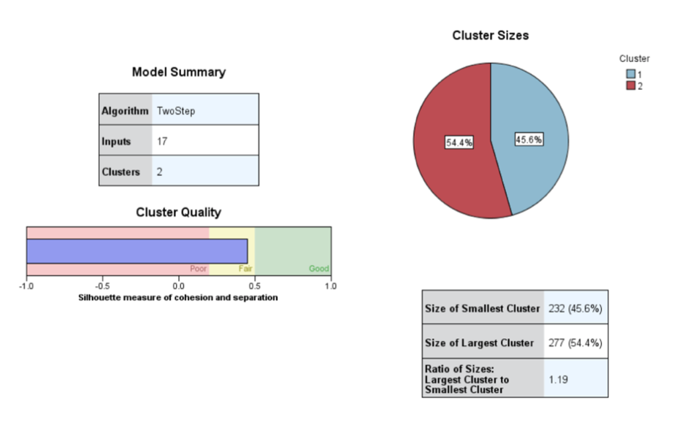
Level 2: Otros

Slide 19
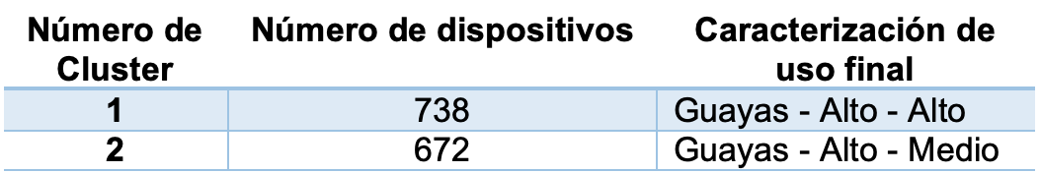
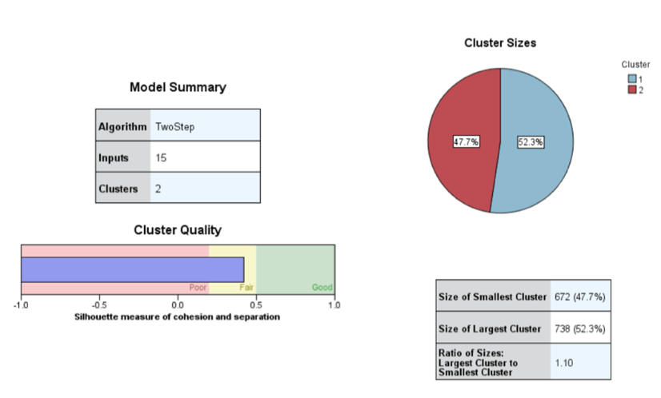
Level 3: Guayas - Alto

Slide 20
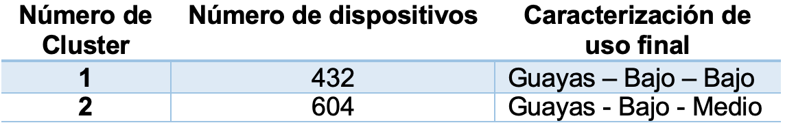
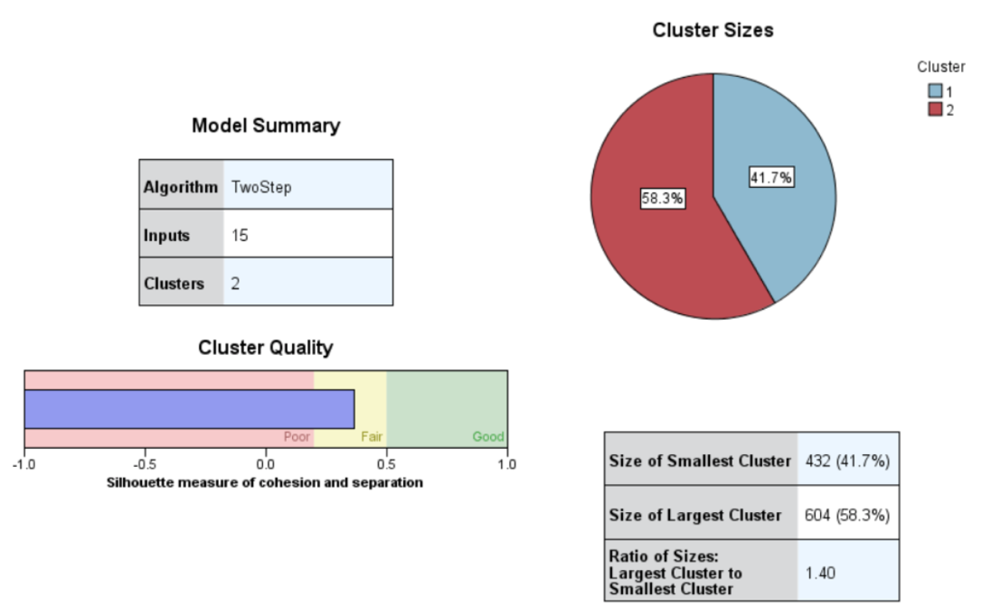
Level 3: Guayas - Bajo

Slide 21
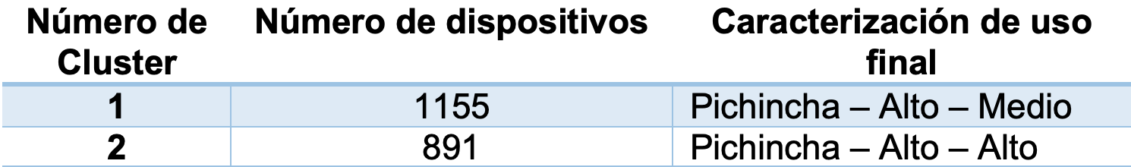
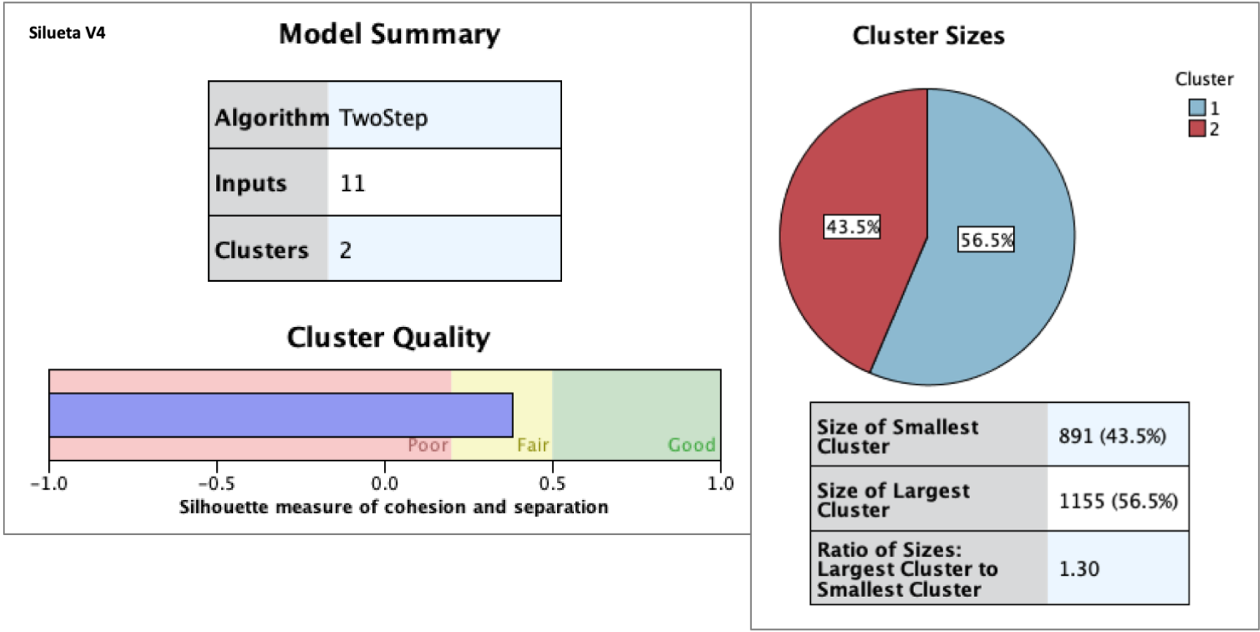
Level 3: Pichincha - Alto

Slide 22
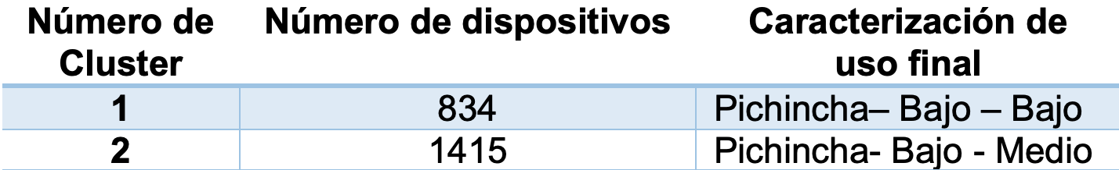
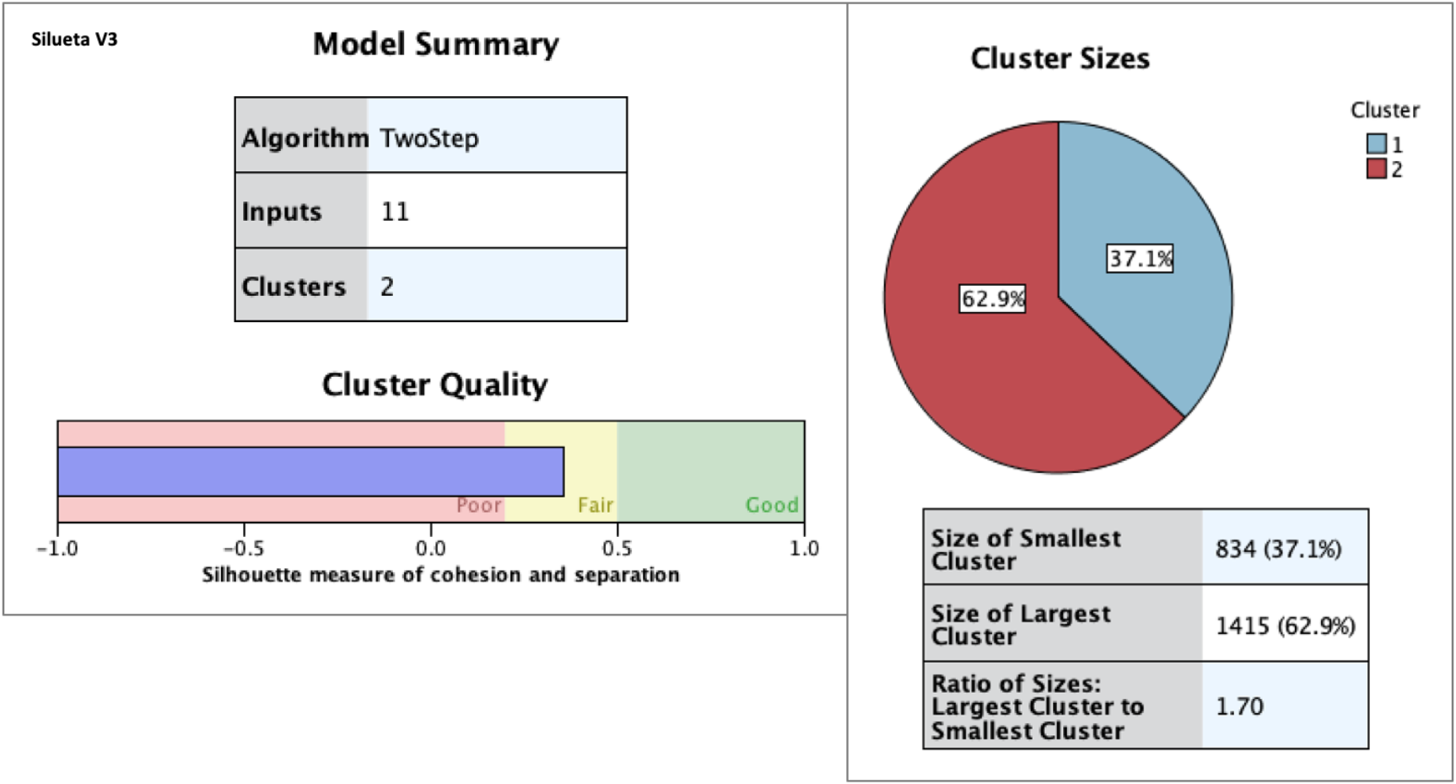
Level 3: Pichincha - Bajo

Slide 23
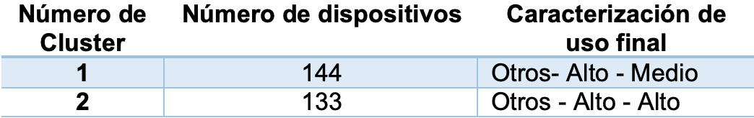
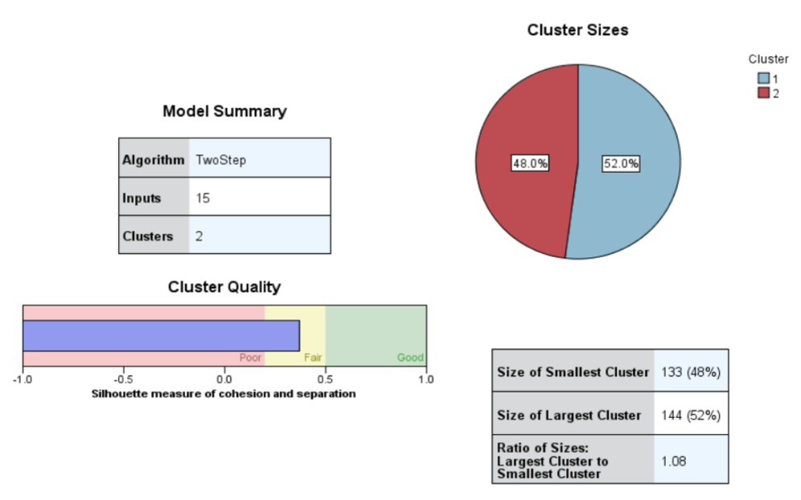
Level 3: Otros - Alto

Slide 24
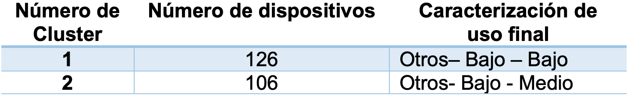
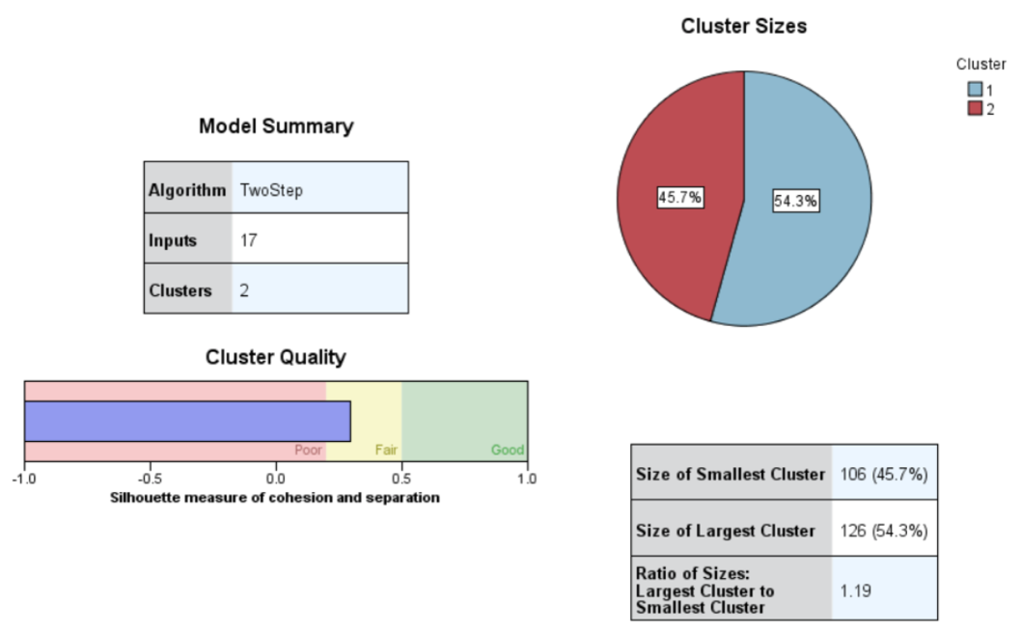
Level 3: Otros - Bajo

Slide 25
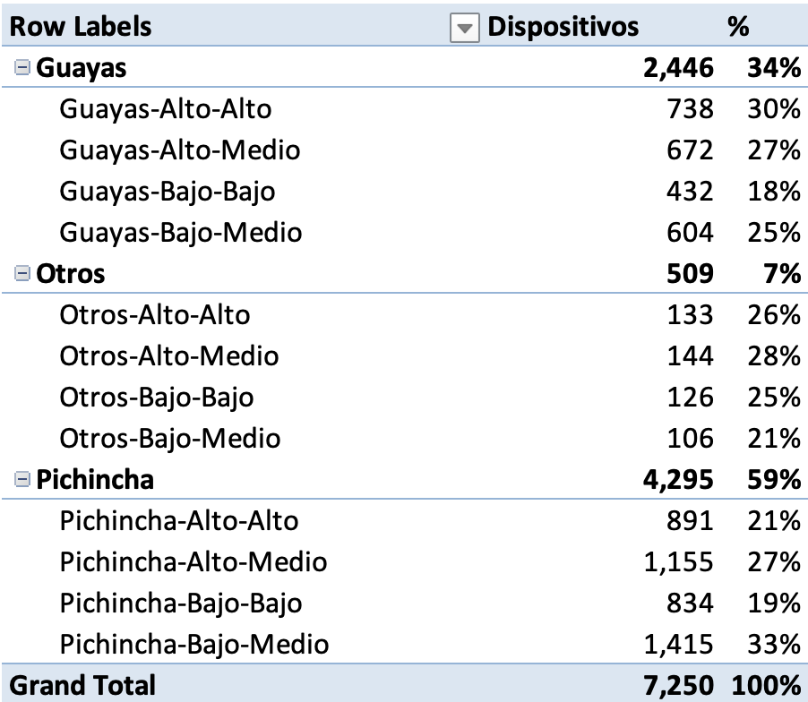
Clustering summary

Slide 26
Steps
1. Sample selection
2. Descriptive Analysis
3. Data Segmentation
4. Classification Model
5. Deployment of the classification model
6. Development of control panels for the model
7. Solution automatization
8. Evolution

Slide 27

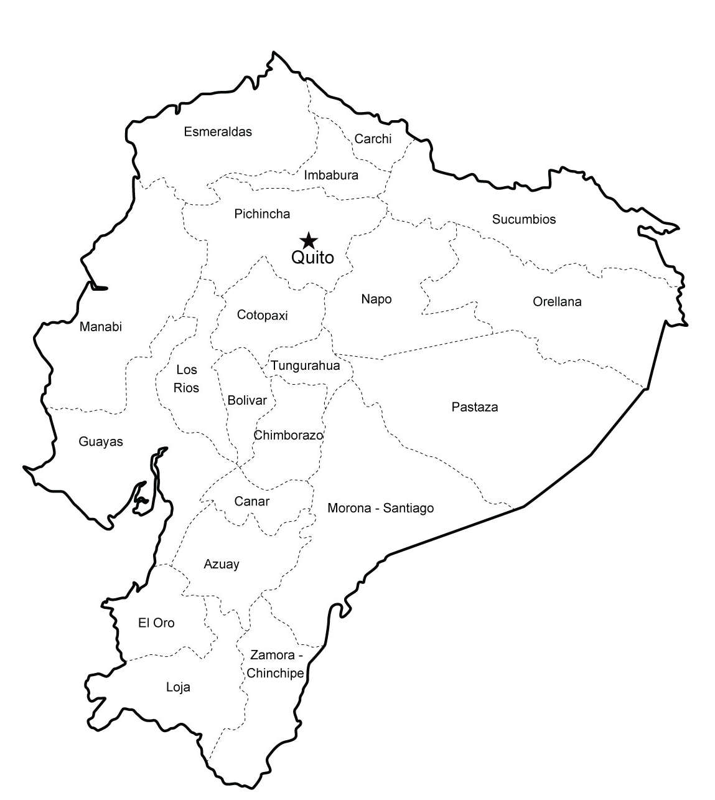
4. Classification model a) Clustering Levels (decision trees)
N1
N2
N3
5
95%
Device Data
Alto
Bajo
Pichincha
Alto
Otros
Bajo
Alto
Bajo
Alto-Alto
Alto-Medio
Bajo-Bajo
Alto-Alto
Alto-Medio
Bajo-Medio
Bajo-Bajo
Alto-Alto
Alto-Medio
Bajo-Medio
Bajo-Bajo
Guayas
Bajo-Medio
2
96%
6
97%
1
7
95%
100%
3
96%
8
97%
9
99%
4
99%
10
96%

Slide 28


4. Classification Model
Tools used:
IBM Watson Studio
Jupyter Notebooks (Python Language)
sklearn decision trees

Slide 29
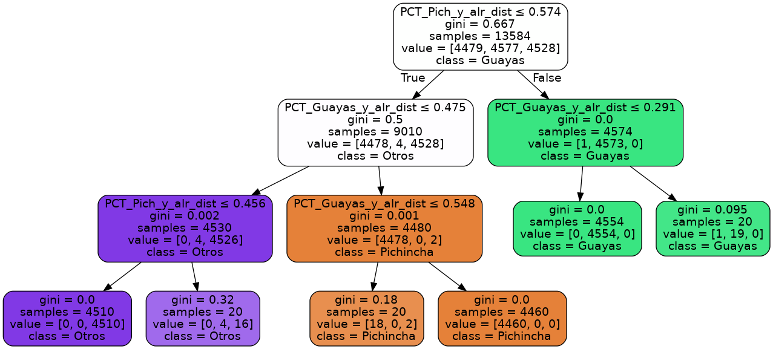
Level 1 Decision Tree

Slide 30
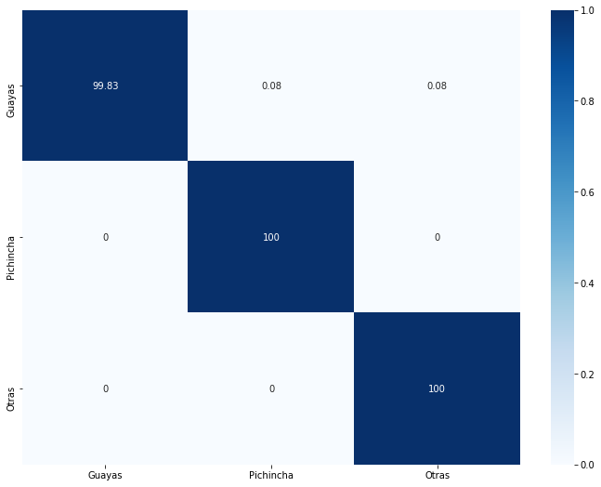
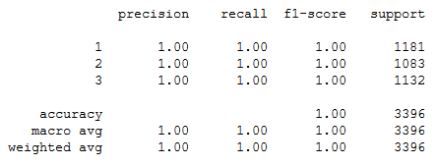
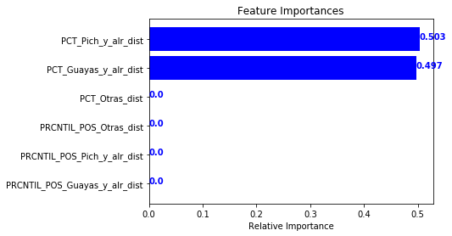
Level 1 Decision Tree: Accuracy

Slide 31
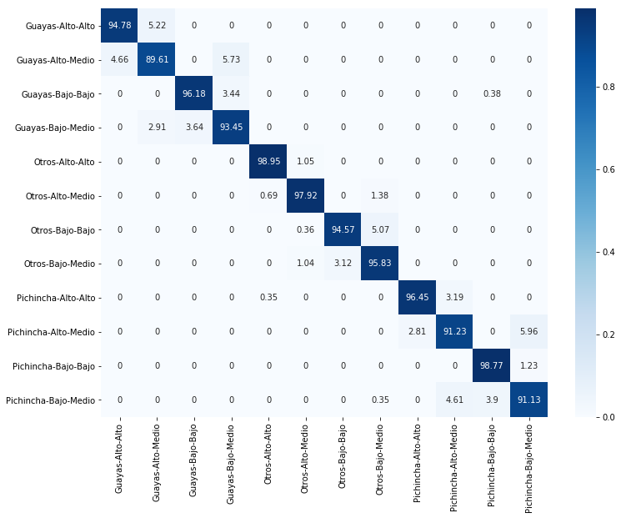
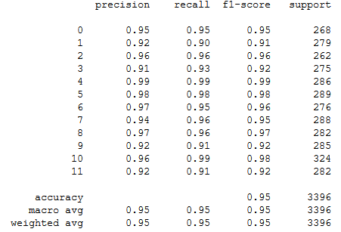
Final accuracy (10 trees from 3 clustering levels)

Slide 32
Final variable selection
Feature engineering
166 variables
Initial selection
110 variables
Reduction with PCA
44 variables
Decision trees variable selection
27 variables
Notes:
Crash Alert 2.5 en funcionamiento desde Marzo 2018

Slide 33
Variable usage per tree

Slide 34
Steps
1. Sample selection
2. Descriptive Analysis
3. Data Segmentation
4. Classification Model
5. Deployment of the classification model
6. Development of control panels for the model
7. Solution automatization
8. Evolution

Slide 35






5. Deployment process
All tres are stored in a GitLab repository
The classification model can be used when need
Model Development

Slide 36
Steps
1. Sample selection
2. Descriptive Analysis
3. Data Segmentation
4. Classification Model
5. Deployment of the classification model
6. Development of control panels for the model
7. Solution automatization
8. Evolution

Slide 37
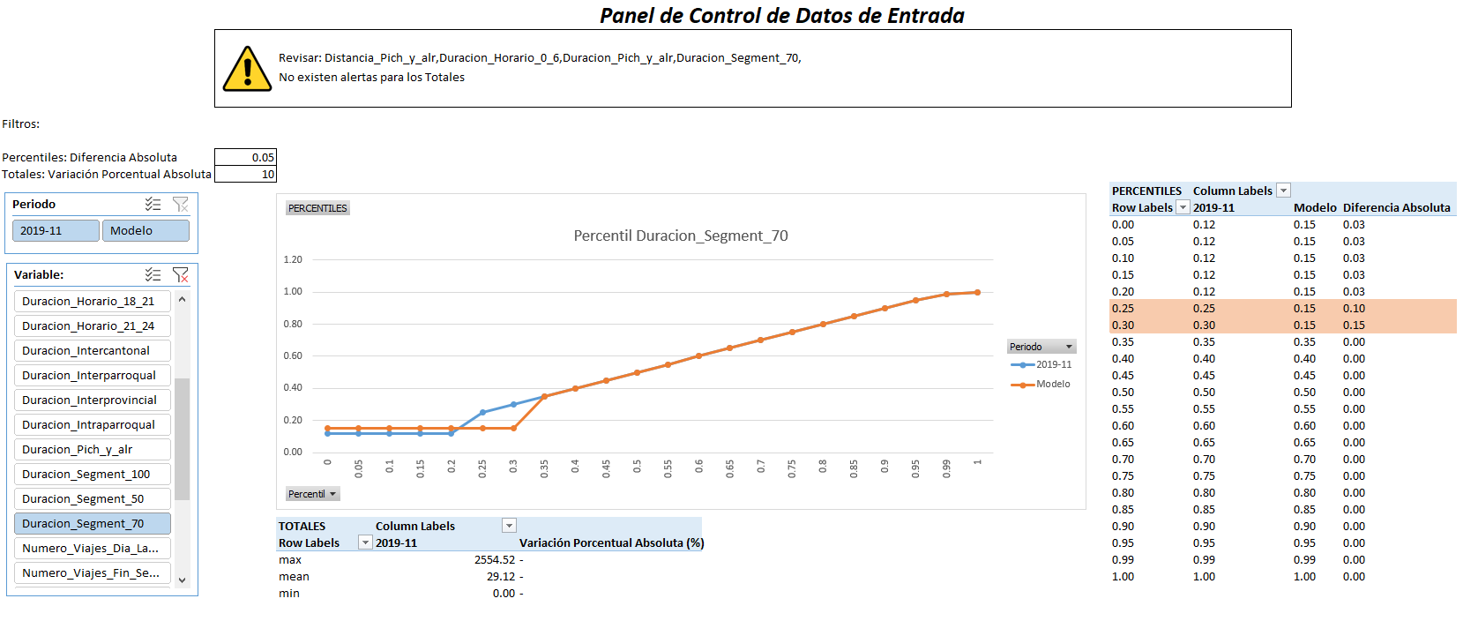
6. Control panels for the model a) Input data – Control Panel

Slide 38
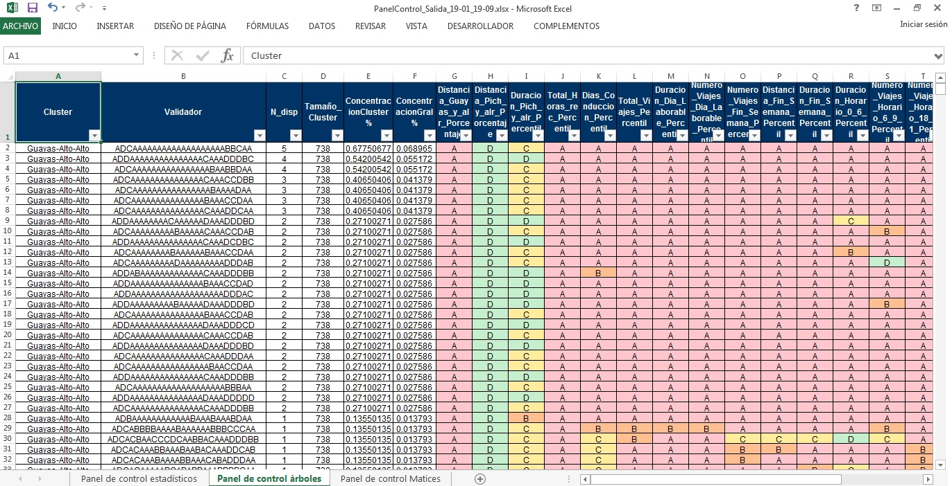
6. Control panels for the model a) Output data – Control Panel

Slide 39
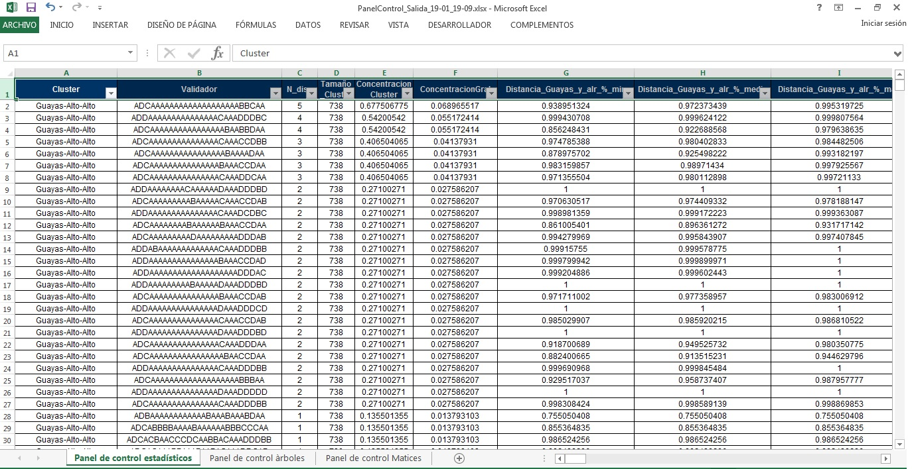
6. Control panels for the model a) Output data – Control Panel

Slide 40
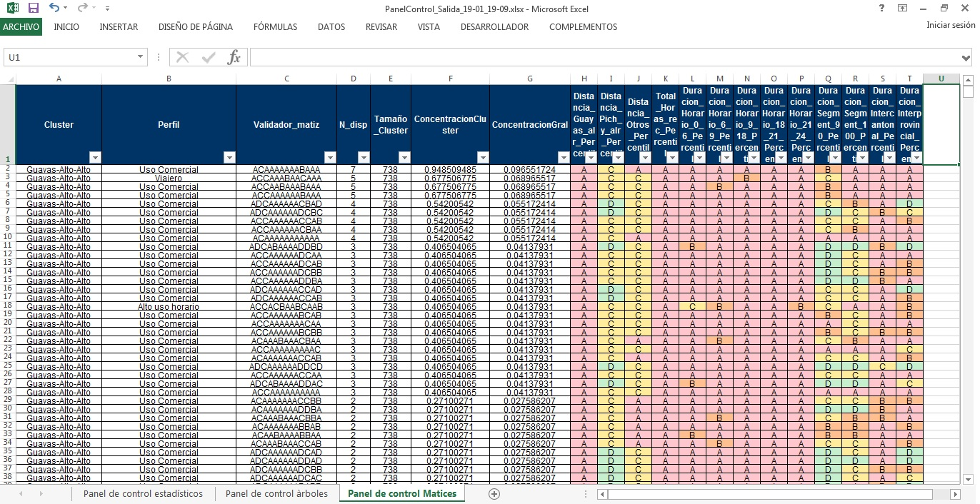
6. Control panels for the model a) Output data – Control Panel

Slide 41
Steps
1. Sample selection
2. Descriptive Analysis
3. Data Segmentation
4. Classification Model
5. Deployment of the classification model
6. Development of control panels for the model
7. Solution automatization
8. Evolution

Slide 42



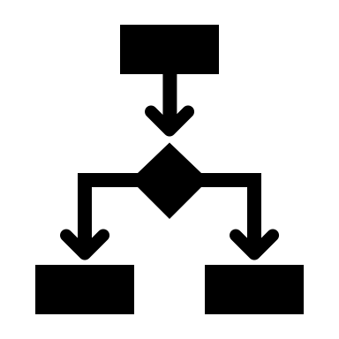

7. Automatization
Telemetry
Trip aggregation
Day aggregation
Device aggregation
Trips
Day/night
City/Cantón/Provincia
…
Decision Trees
Input: device aggregations
Process:
Level 1 (1 tree)
Level 2 (3 trees)
Level 3 (6 trees)
Output:
One of 12 categories for each device
Dashboard

Slide 43
Steps
1. Sample selection
2. Descriptive Analysis
3. Data Segmentation
4. Classification Model
5. Deployment of the classification model
6. Development of control panels for the model
7. Solution automatization
8. Evolution

Slide 44
8. Next Steps
1. Development of a dashboard with insights for managers
2. Development of a R Shiny app for the control panels
4. Solution automatization optimization

